Slide 1



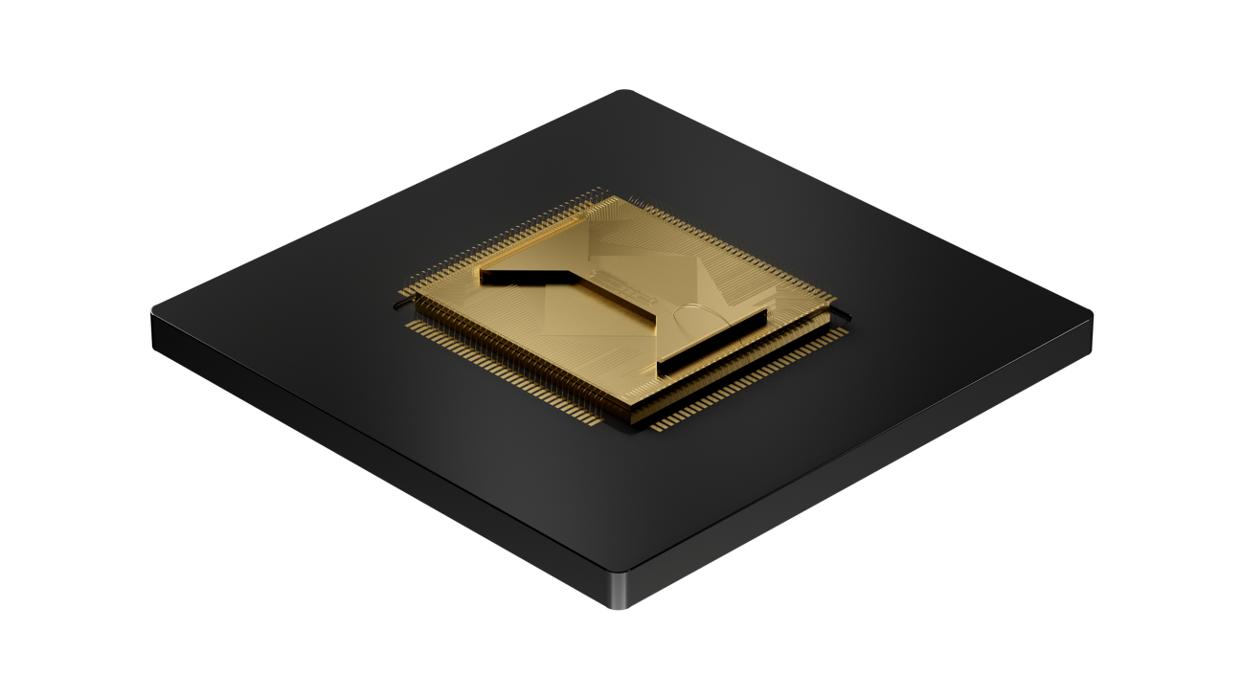
Quantinuum Systems with NVIDIA CUDA-Q
Enrico Rinaldi and Kentaro Yamamoto
10, March, 2025 @ SCA25, Singapore
© 2025 Quantinuum. All Rights Reserved.

Slide 2

Quantinuum at a glance
550+
employees across 8 offices
420+
PhDs and Masters
Largest concentration of quantum experts outside of academia
130+
global patents
~200
scientific papers
Cross-domain subject matter expertise:
Chemistry | Materials science
Artificial intelligence | Machine learning Condensed matter | Cybersecurity Encryption | Finance
© 2025 Quantinuum. All Rights Reserved.

Slide 3
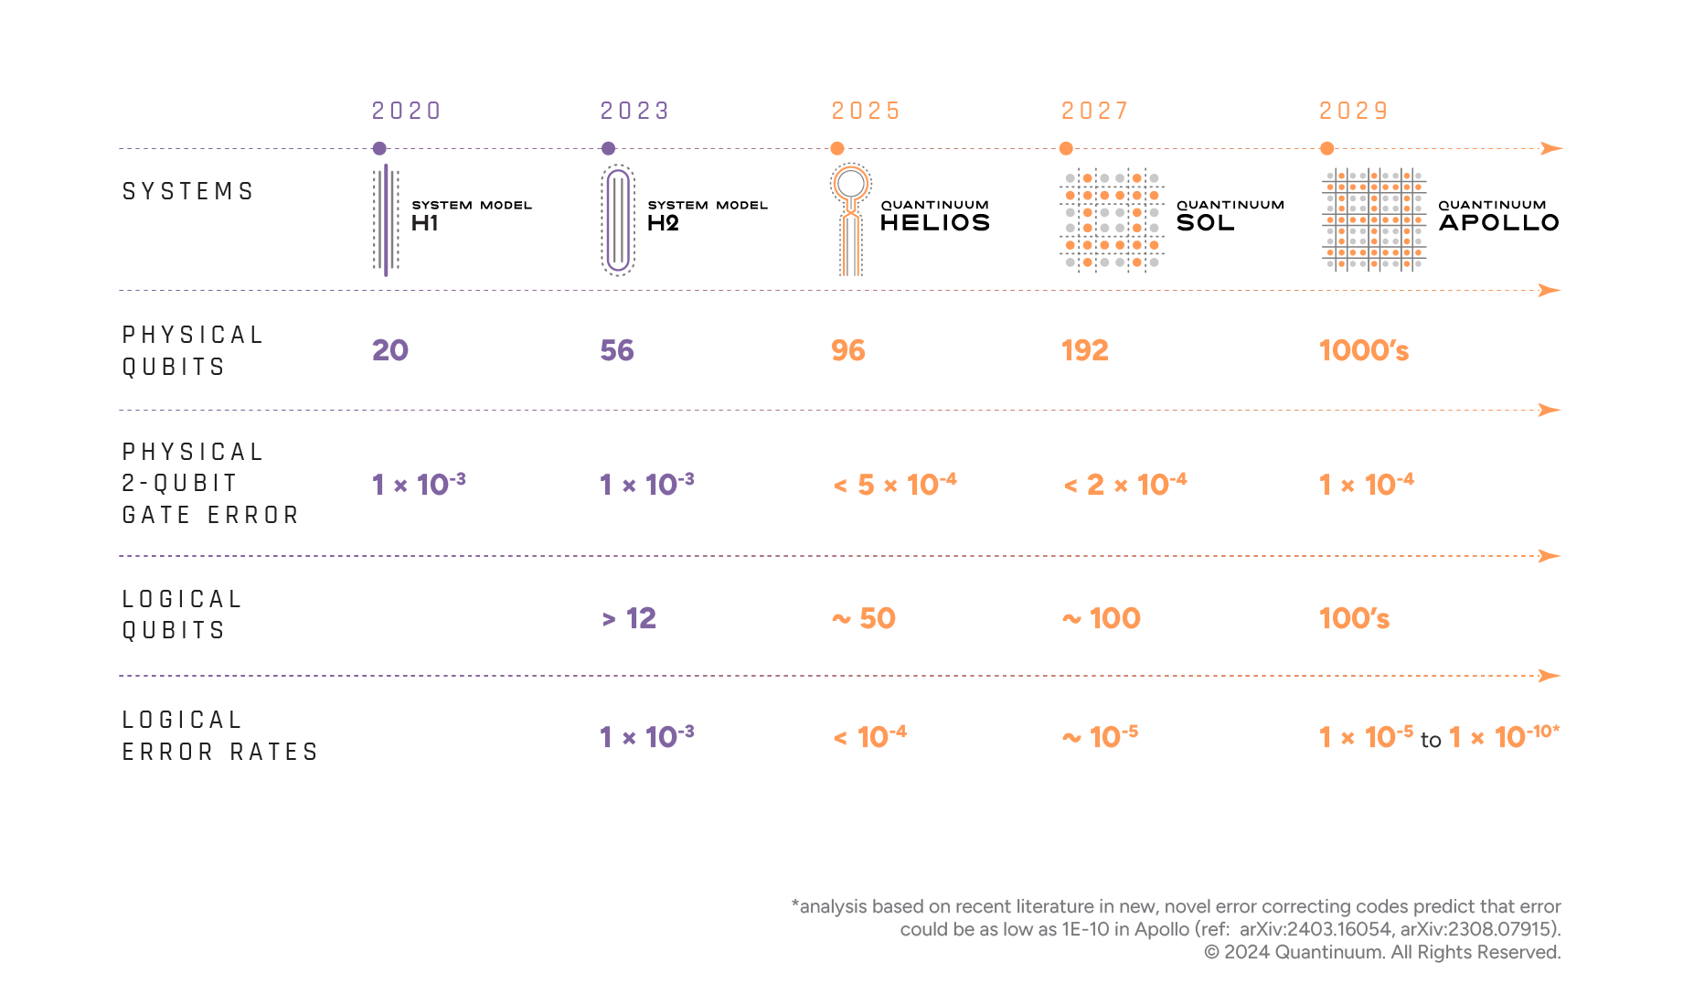
Our roadmap
to universal, fault-tolerant quantum computing

Slide 4
Our business model is
differentiated and resilient: a true full stack
Cybersecurity
Quantum Chemistry
Quantum AI
Ecosystem Platforms
Quantum Origin: Enterprise-grade quantum computing-enable cryptographic solutions
InQuanto: transforming the discovery of new materials and novel processes
Aiming to solve commercial and specific problems that cannot be solved using today’s classical computers
Enables other partners to leverage the power of quantum via open-source access
TKET
High-performance quantum software development kit | Open-sourced
Nexus – Quantum Operating System
Complete software platform that allows developers to build and deploy algorithms with minimum effort and maximum flexibility
Ecosystem Quantum Processors
Quantinuum Systems
Quantum Computers
Ecosystem Quantum Processors
Quantinuum Products
Partner/Ecosystem Products
© 2054 Quantinuum. All Rights Reserved.

Slide 5
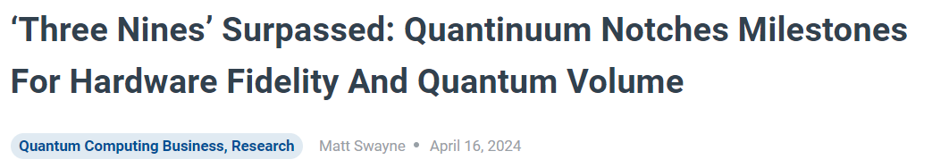

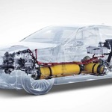
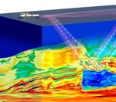

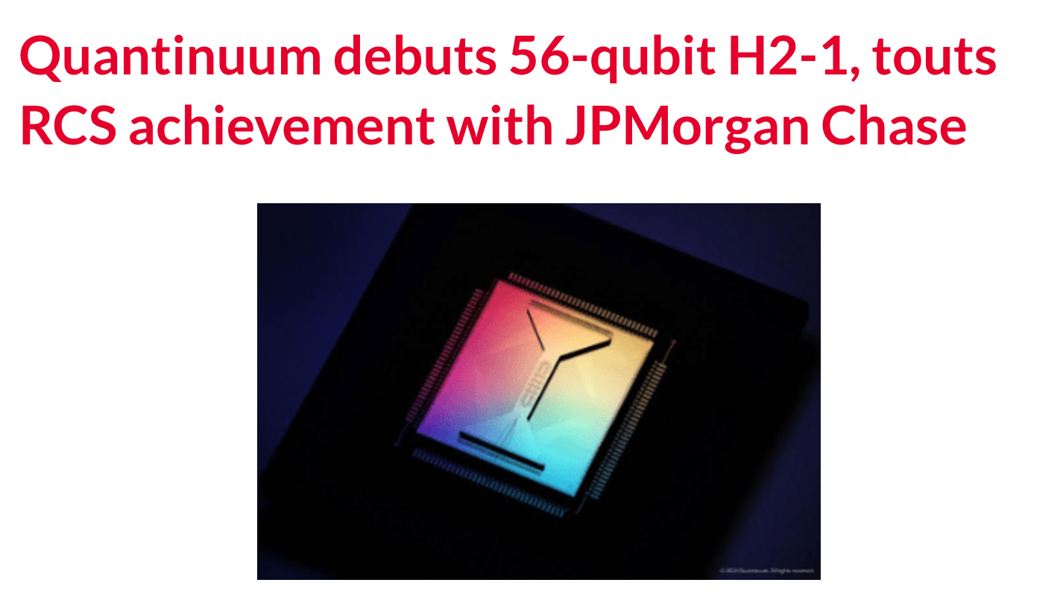
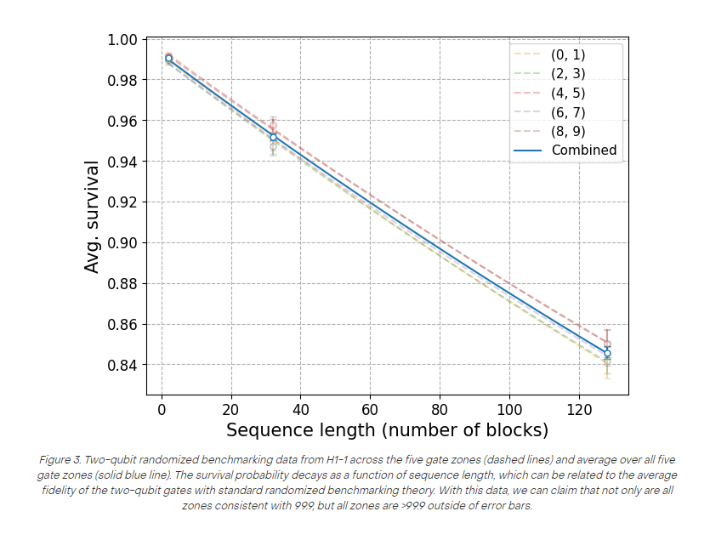
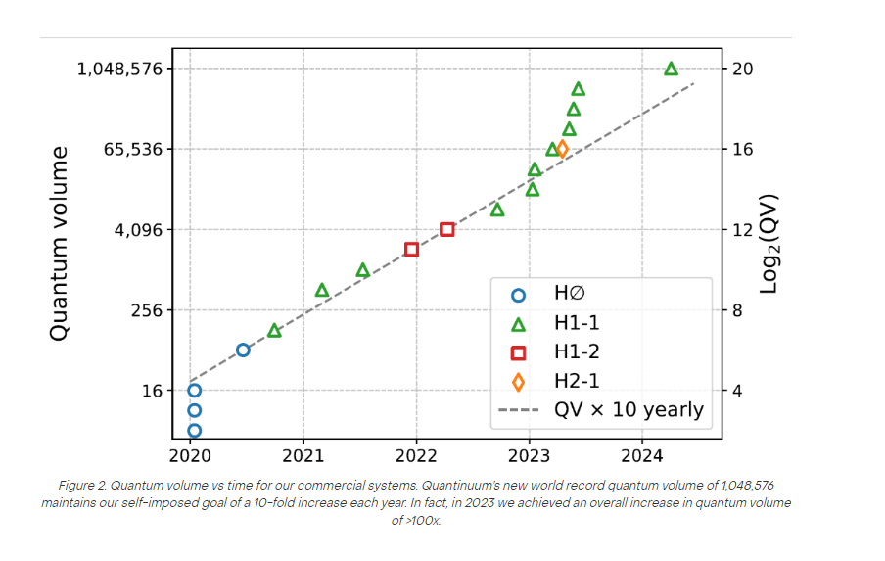

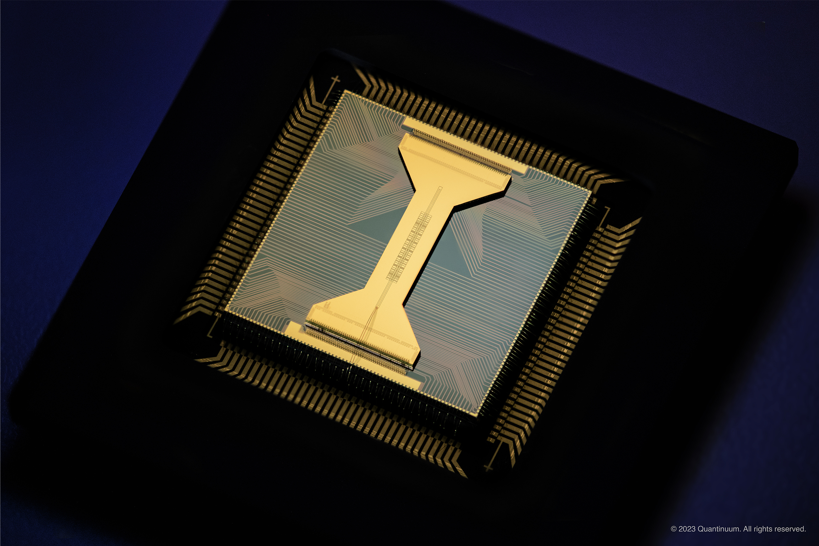


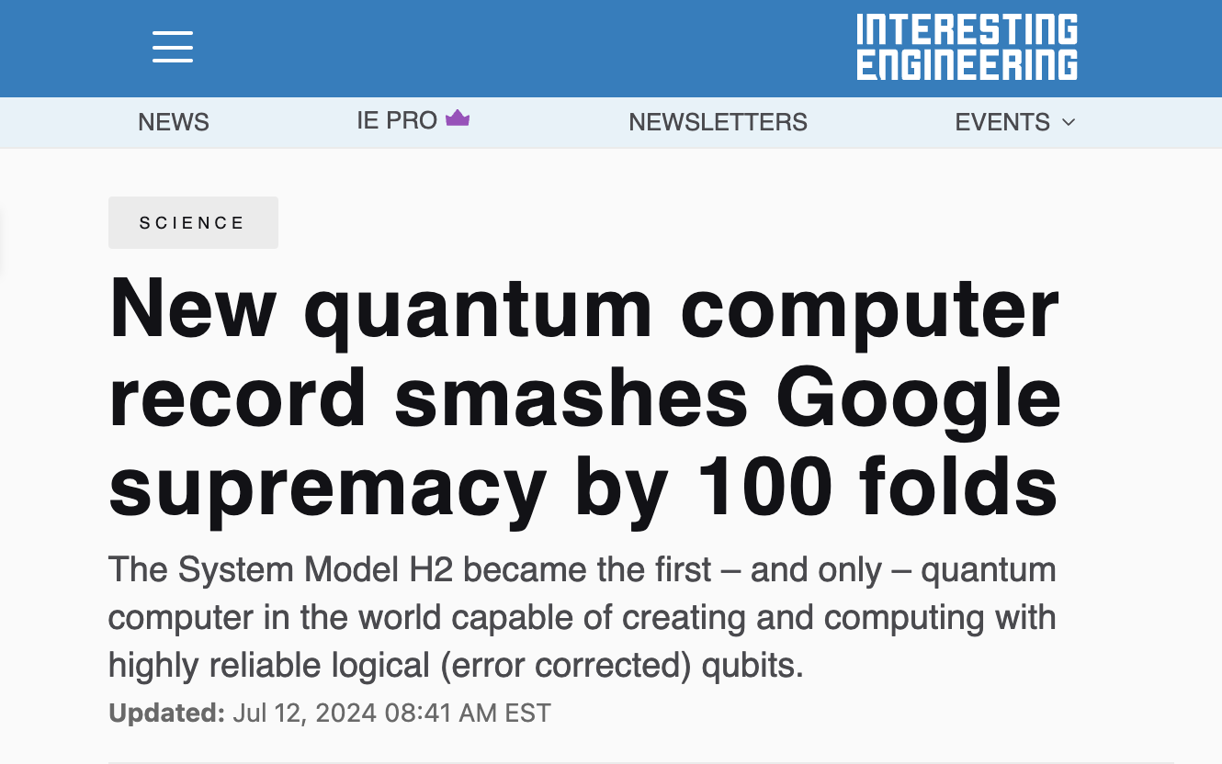
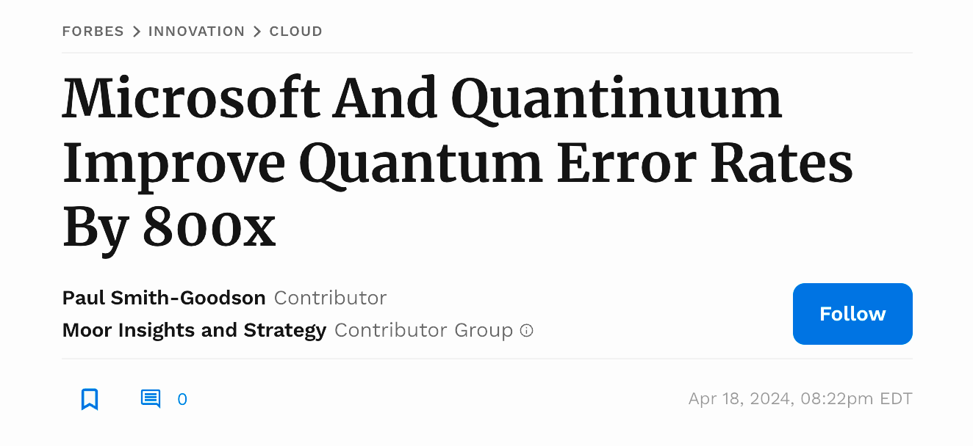
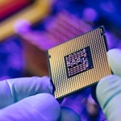

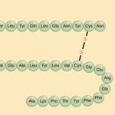
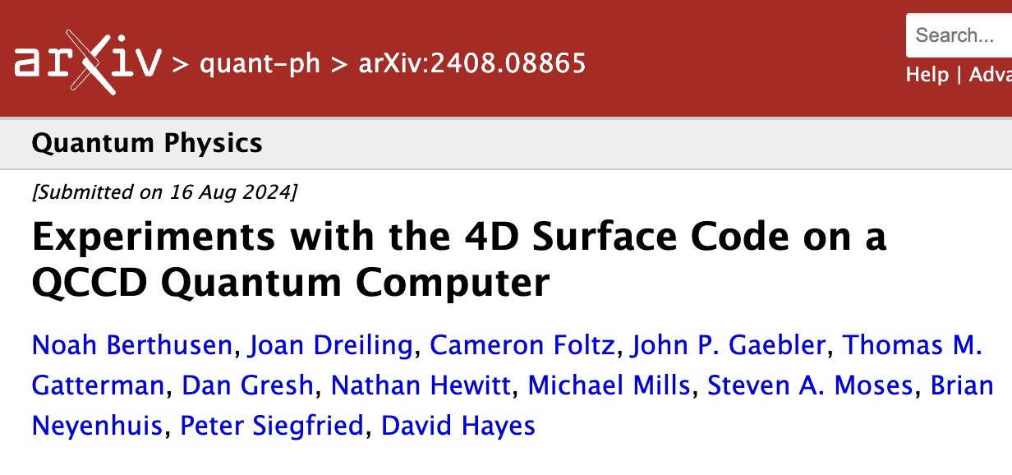
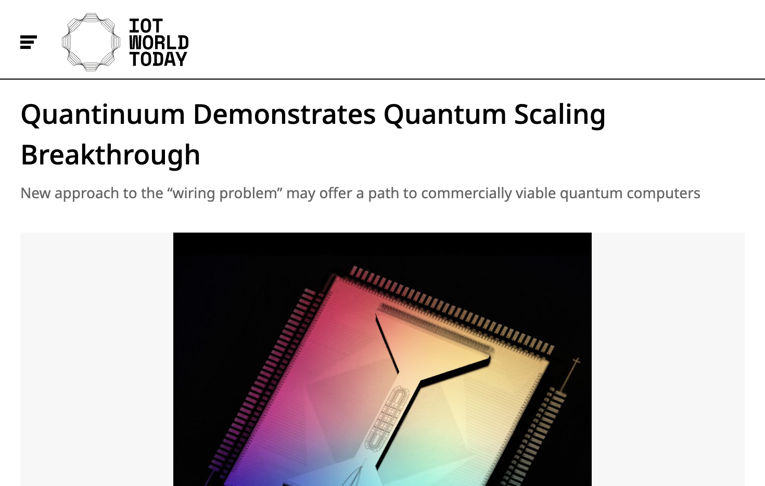



Leading research with our partners…
BMW, Airbus
BP
HSBC
Fuel cell catalytic reactions
Seismic imaging
Fraud detection
TotalEnergies
Riken
Singapore
Carbon capture materials
Integrating HPC with quantum
Computational biology
JSR
Thales
AMGEN
Semiconductor defects
Stronger cryptography
QNLP for
peptide binding
JPMorgan Chase
Honeywell
Equinor
Efficient synthesis of refrigerants
Ammonia catalysis
Financial Operations
Notes:
TECHNICAL LEADERSHIP
FIRST ROW: WORLD’S HIGHEST PERFORMING QCs DEMONSTRATING HIGHEST FIDELITIES (“3 9s” H1 & H2) AND BENCHMARK (QV) PERFORMANCE (2^21 ON H2-56)
SECOND ROW: BREAKTHROUGH RESULTS – UNIQUELY ONLY ON QUANTINUUM’s QCs (FIDELITY, SCALE, ARCHITECTURAL FEATURES – ALL to ALL, MID CYCLE MEASUREMEN
MICROSOFT: 800X - LARGEST GAP - BETWEEN PHYSICAL AND LOGICAL ERROR RATES WITH ACTIVE SYDROME EXTRACTION
RCS BENCHMARK – 100X MORE ACCURATE … 30K LESS ENERGY CONSUMPTION THAN EQUIVALENT CLASSICAL SUPERCOMPUTER
LAST ROW: ACCLERATING INNOVATION IN BOTH ERROR CORRECTION & QUBIT SCALING
4D SURFACE CODE: SINGLE SHOT ERROR CORRECTION – ONLY WITH ALL-TO-ALL CONNECTIVITY
SOLVING THE “WIRING PROBLEM” FOR QUBIT SCALING … ENDING THE MYTH THAT TRAPPED ION INHERENTLY NON-SCALABLE
<CLICK FOR RHS>
PARTNERING WITH THE BIGGEST NAMES ACROSS A BROAD RANGE OF END MARKETS: TRANSPORTATION, FINANCIAL, CHEMISTRY, LIFE SCIENCES, BASIC R&D
HELPING CREATE THEIR QUANTUM AGENDA → BUILDING THEIR QUANTUM JOURNEY
<CLICK TO NEXT SLIDE>

Slide 6
Quantum Phase Estimation
On Quantinuum Systems with Nvidia CUDA-Q

Slide 7
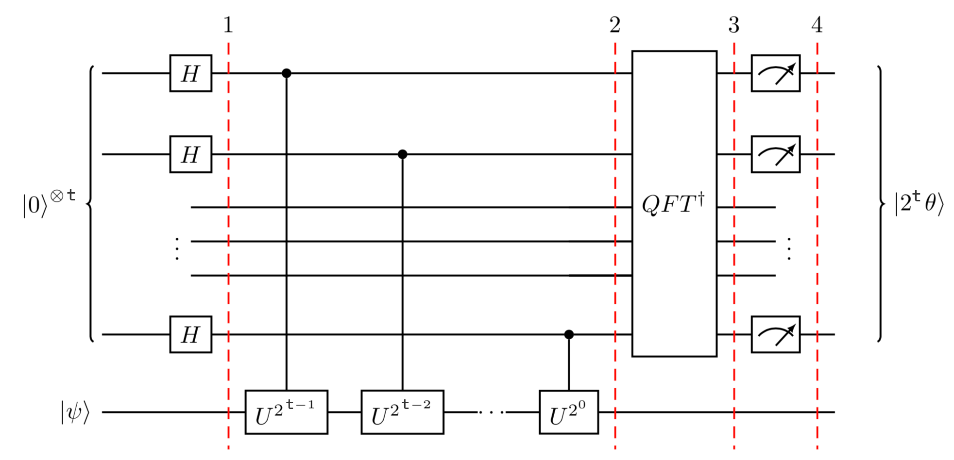
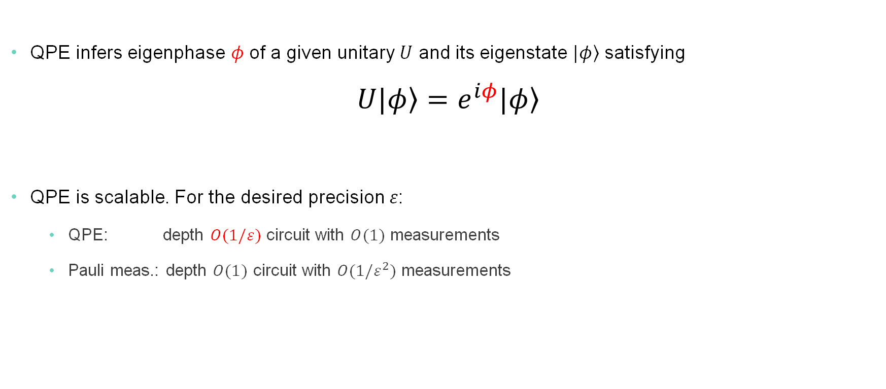
Quantum Phase Estimation (QPE)
An important subroutine of many quantum algorithms (e.g., Shor’s algorithm and quantum chemistry).
QPE infers eigenphase $φ$ of a given unitary $U$ and its eigenstate $|\left.φ\right\rangle$ satisfying $U|\left.φ\right\rangle =e^{iφ}|\left.φ\right\rangle$
QPE is scalable. For the desired precision $ε$:
QPE: depth $O(1/ε)$ circuit with $O(1)$ measurements
Pauli meas.: depth $O(1)$ circuit with $O(1{/ε}^{2})$ measurements
Deeper circuit → higher precision

Slide 8
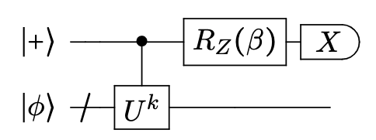
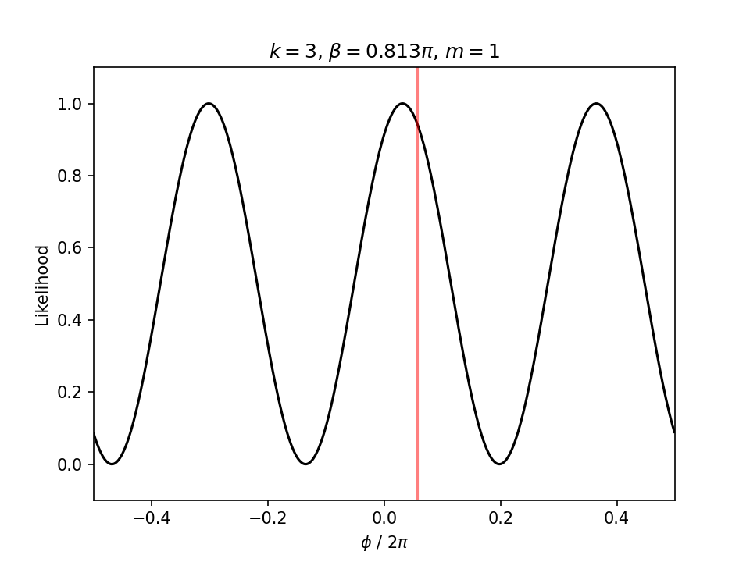
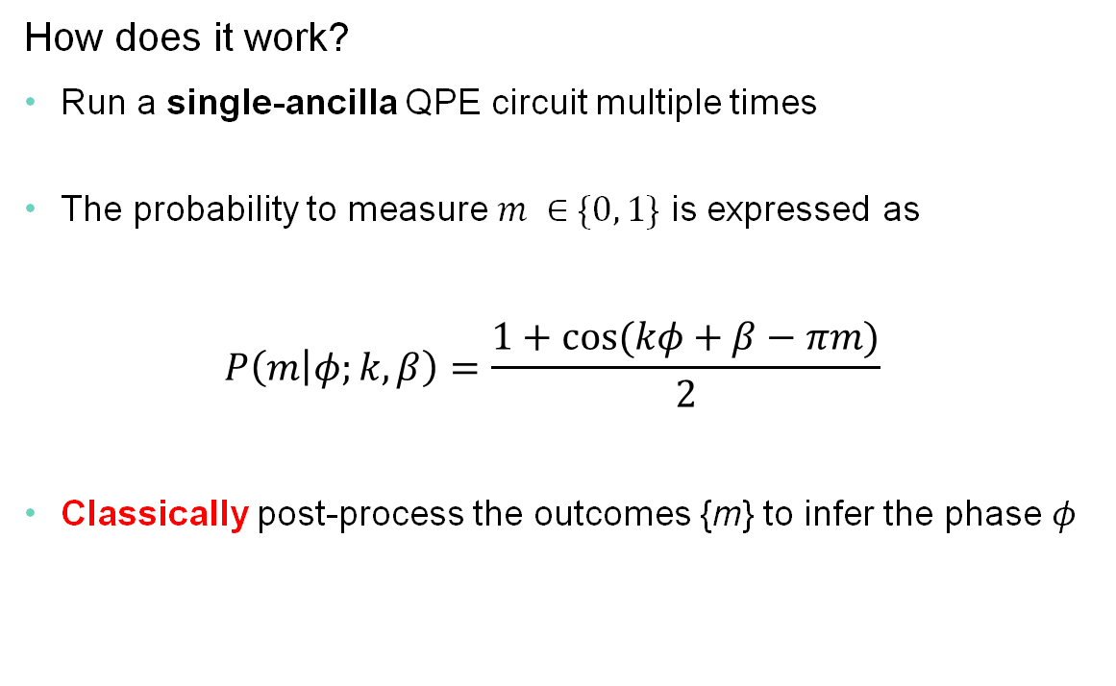

Single ancilla QPE
Classical signal processing replaces quantum Fourier transform (QFT) in the canonical QPE.
How does it work?
Run a single-ancilla QPE circuit multiple times
The probability to measure $m ∈\{0, 1\}$ is expressed as $P\left(m | φ;k,β\right)=\frac{1+cos⁡(kφ+β−πm)}{2}$
Classically post-process the outcomes {m} to infer the phase $φ$
Parameters: $k∈ℕ, β∈[0, 2π)$

Slide 9
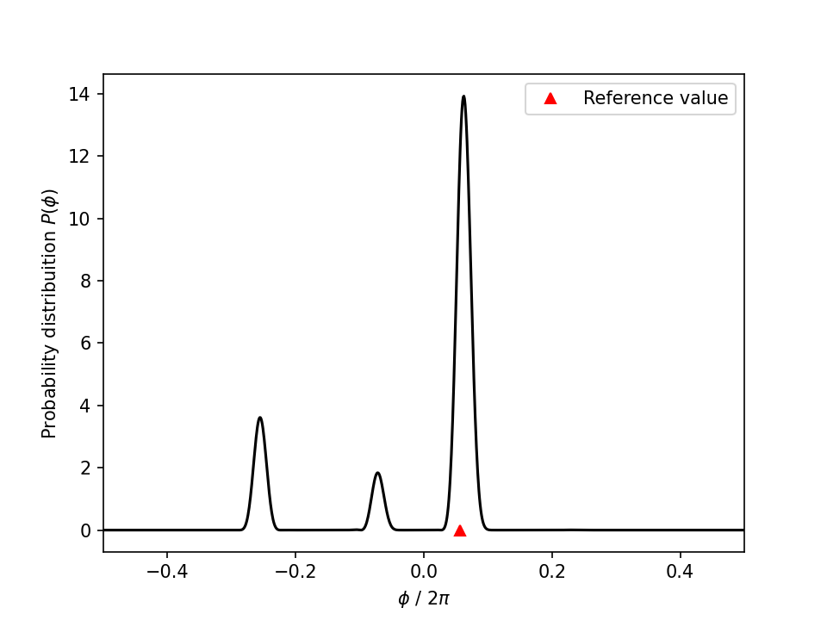
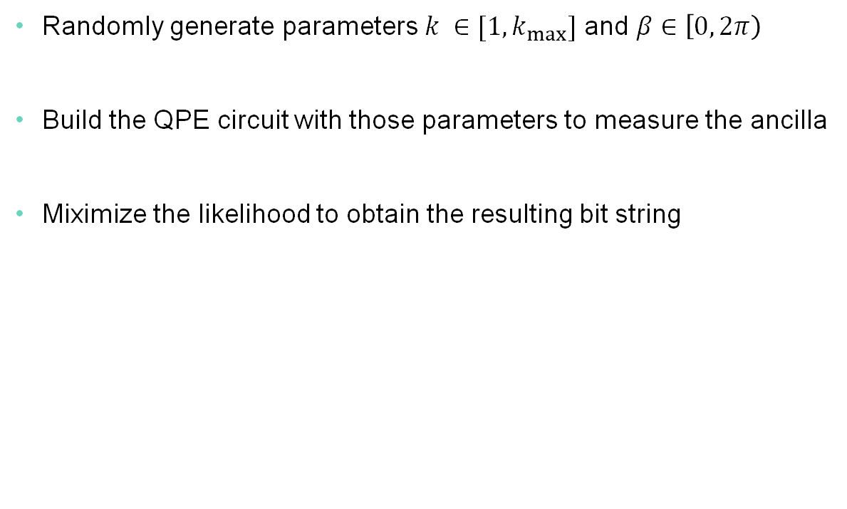
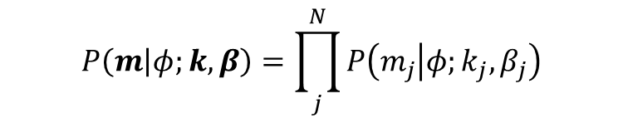
Information theoretic QPE [1] as an example
Basic stochastic QPE algorithm using single-ancilla QPE circuits
Randomly generate parameters $k ∈[1, k_{max}]$ and $β∈\left[0, 2π\right)$
Build the QPE circuit with those parameters to measure the ancilla
Miximize the likelihood to obtain the resulting bit string
Parameters: $k∈ℕ, β∈[0, 2π)$
Maximum likelihood estimate
$$P\left(m | φ;k,β\right)=\prod_{j}^{N}{P\left(m_{j} | φ;k_{j},β_{j}\right)}$$
[1] K. M. Svore et al., Quantum Inf. Comput. 14, 306 (2014).

Slide 10
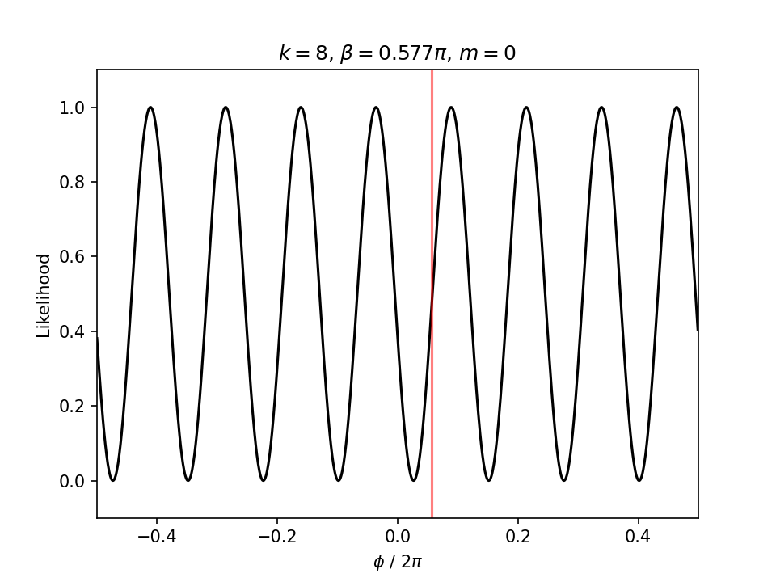
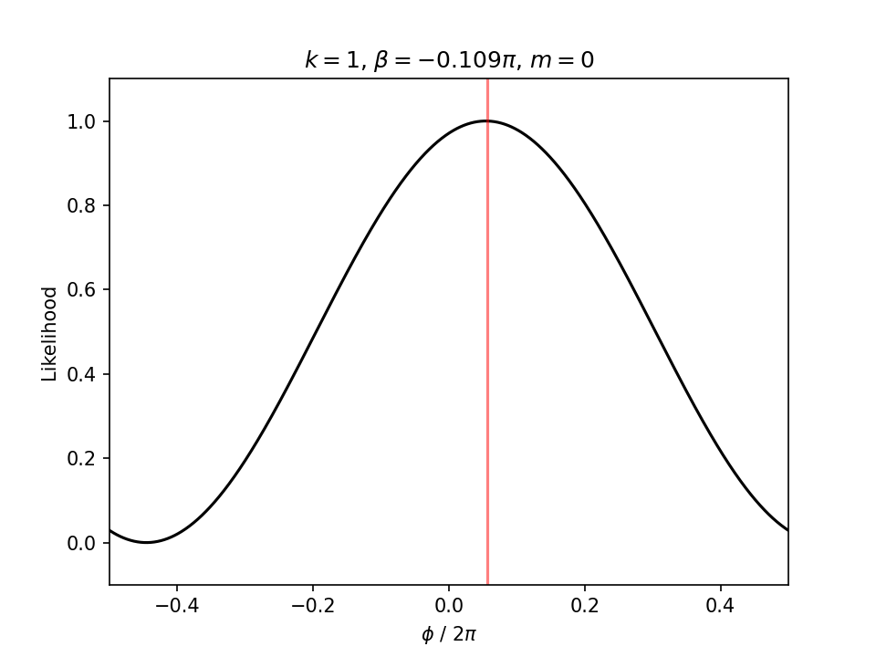
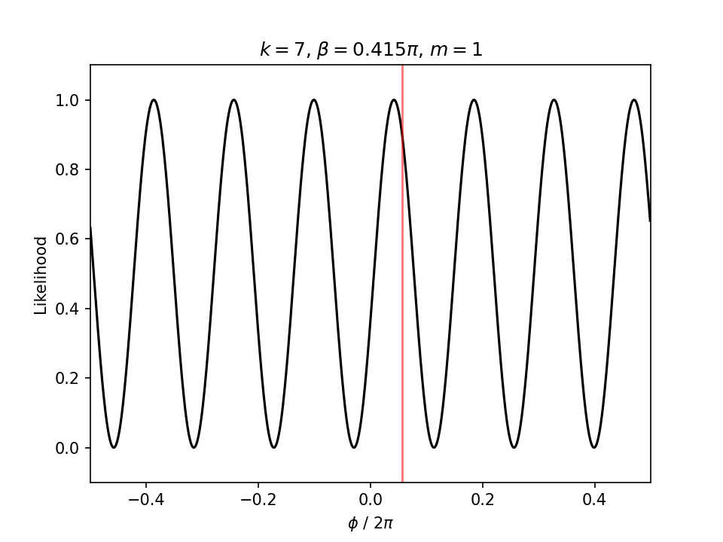
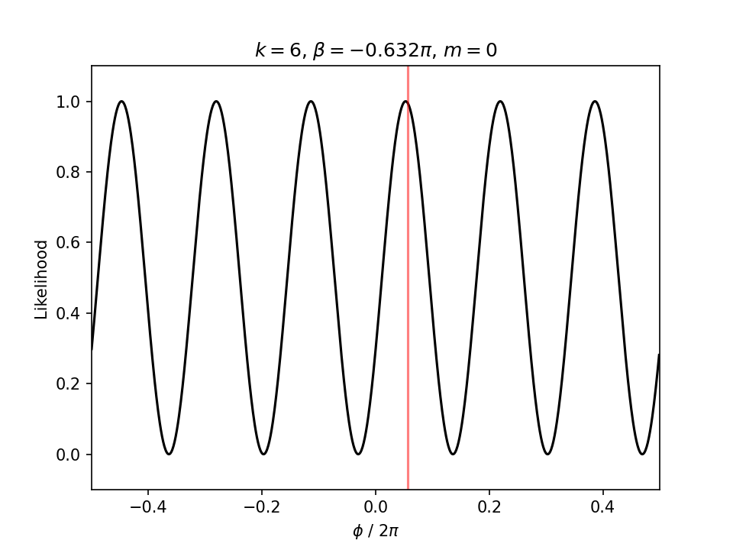
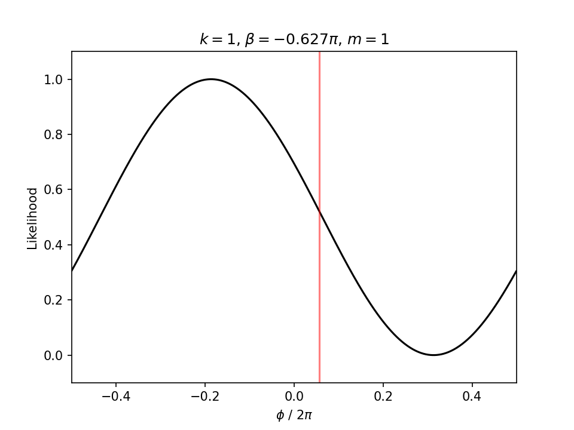
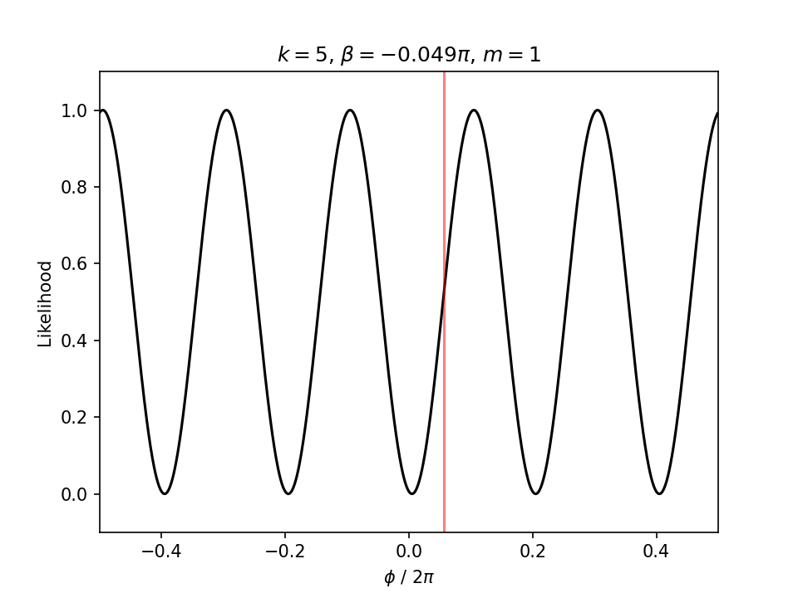
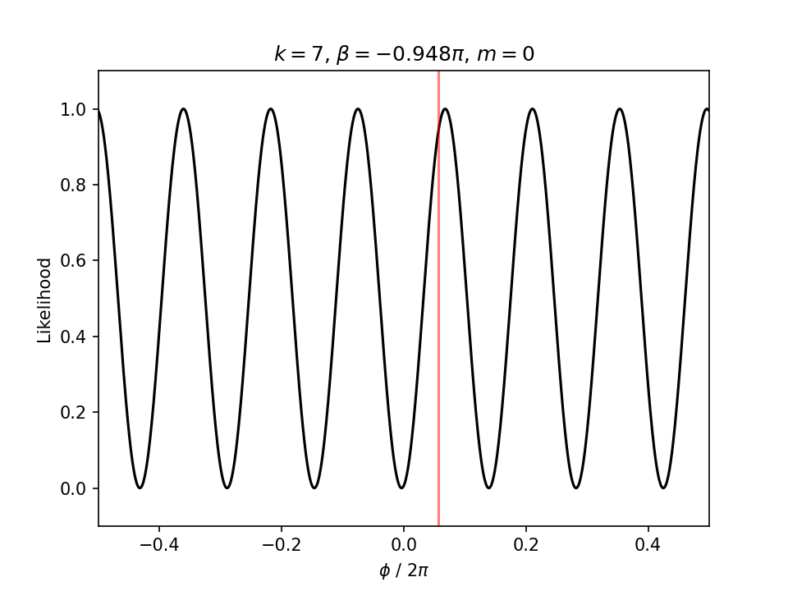
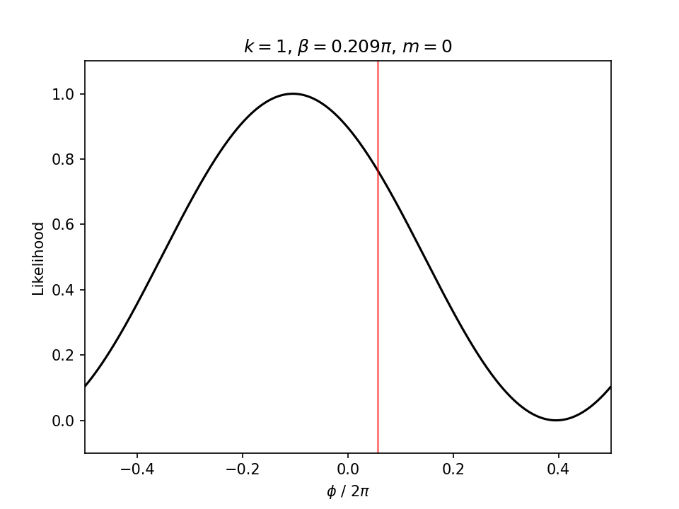
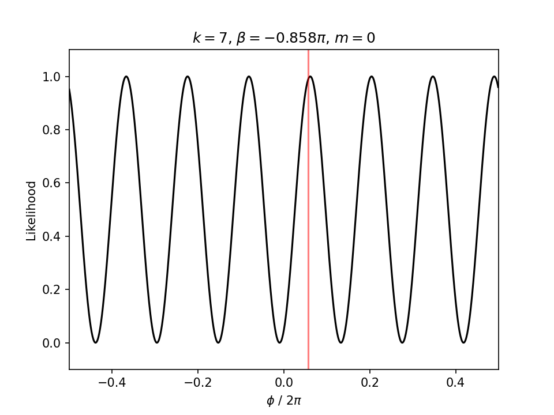
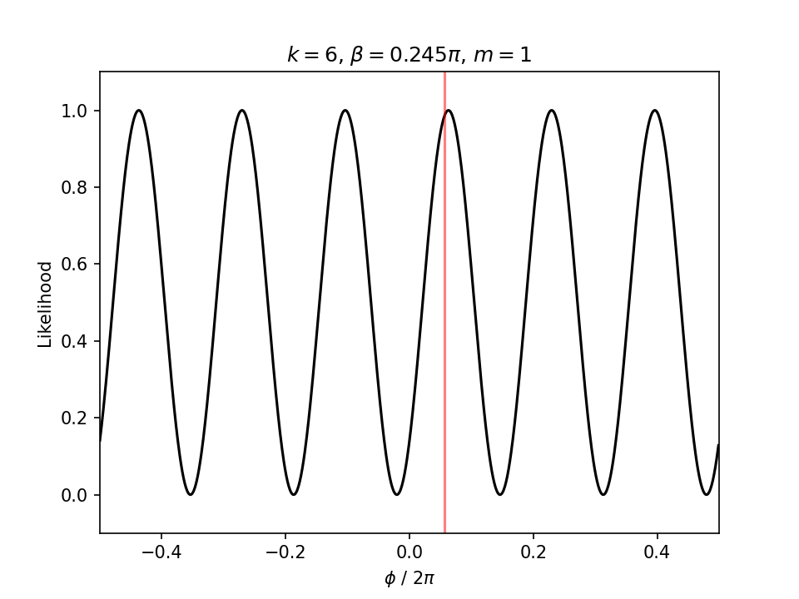
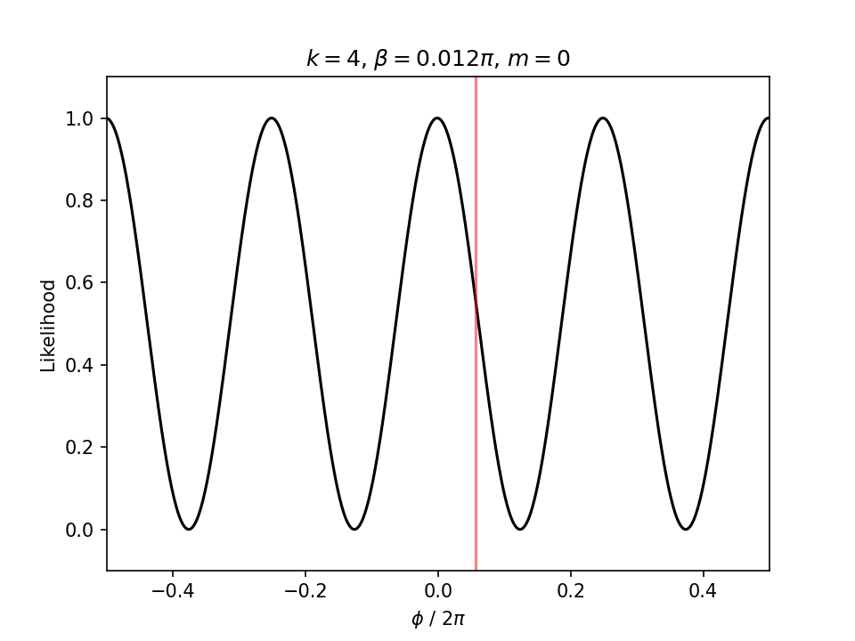
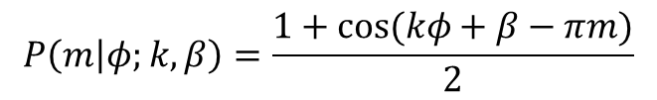
$$P\left(m | φ;k,β\right)=\frac{1+cos⁡(kφ+β−πm)}{2}$$

Slide 11
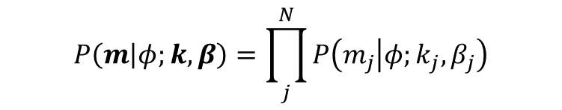
$$P\left(m | φ;k,β\right)=\prod_{j}^{N}{P\left(m_{j} | φ;k_{j},β_{j}\right)}$$
x
x
x
x
x
x
x
x
x
x
x

Slide 12
$$P\left(m | φ;k,β\right)=\prod_{j}^{N}{P\left(m_{j} | φ;k_{j},β_{j}\right)}$$
x
x
x
x
x
x
x
x
x
x
x

Slide 13
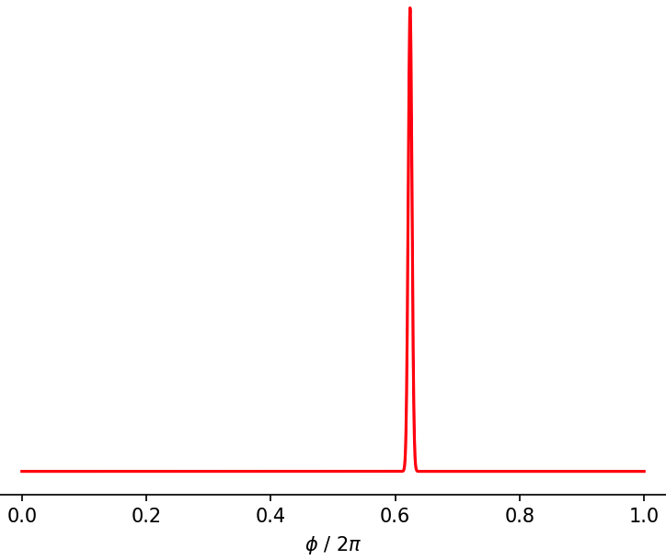
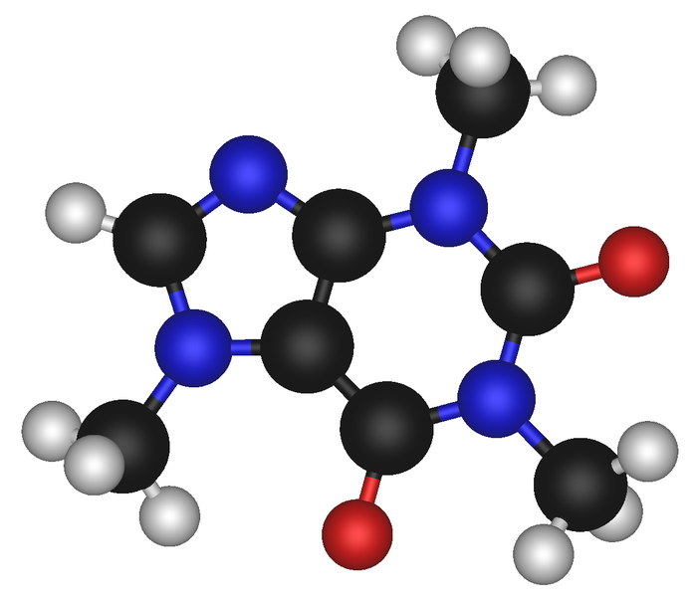
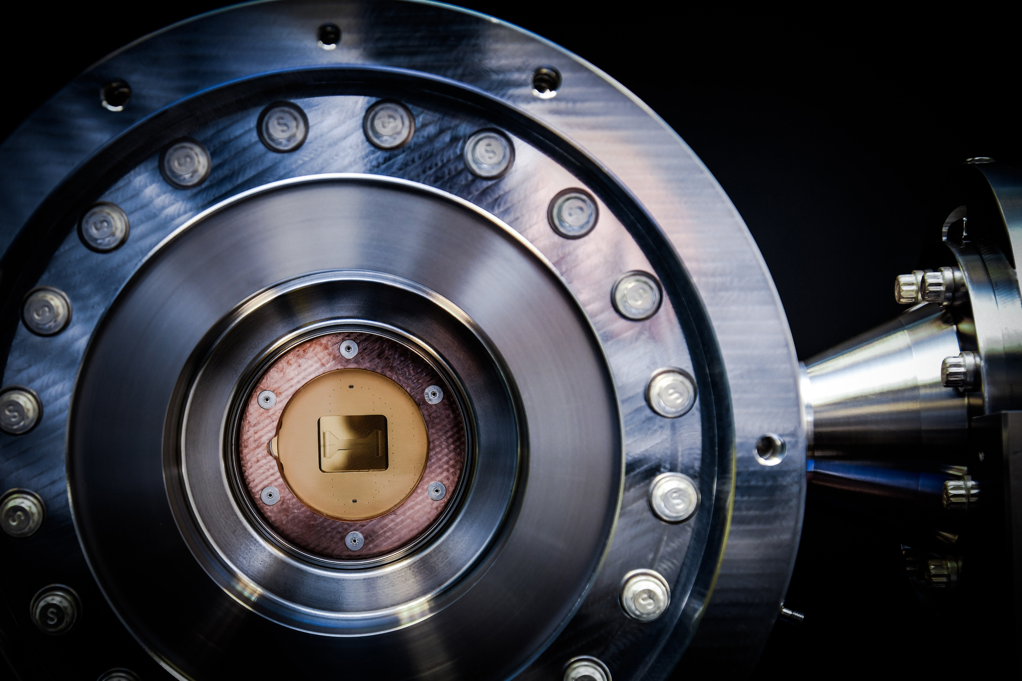
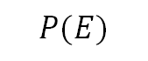

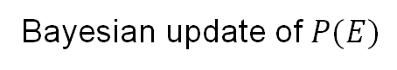
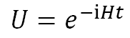
Overview of QPE experiments for chemistry
Bayesian QPE workflow:
Bayesian update of $P(E)$
$$P(E)$$
$$U=e^{−iHt}$$
Parameters: $k∈ℕ, β∈[0, 2π)$
Choose a molecule
Build a QPE circuit
Hardware execution
Estimate the energy

Slide 14
Overview of QPE experiments for chemistry
Bayesian QPE workflow:
Bayesian update of $P(E)$
$$P(E)$$
$$U=e^{−iHt}$$
Parameters: $k∈ℕ, β∈[0, 2π)$
Choose a molecule
Build a QPE circuit
Hardware execution
Estimate the energy
Logical qubits
by the QEC/QEC code
Encoding
QEC/QED
Interpretation
QEC = (quantum error correction)
Error correction is required to implement QPE
QED = (quantum error detection)

Slide 15
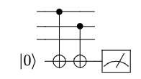
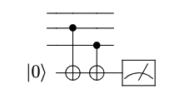
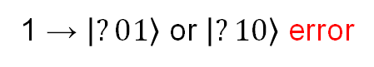
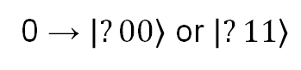
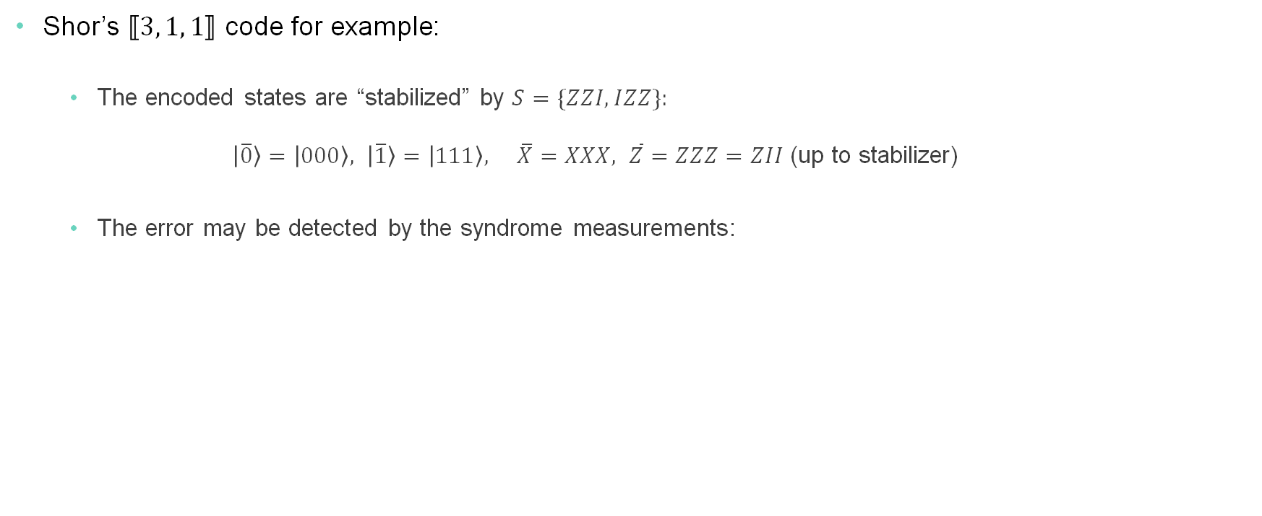



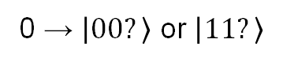
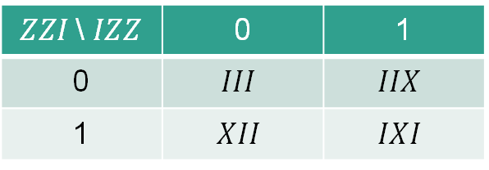
Quantum error correction
Detect, identify, and correct the error by exploiting the redundancy.
Shor’s $⟦3, 1, 1⟧$ code for example:
The encoded states are “stabilized” by $S=\{ZZI, IZZ\}:$ $\left|\overline{0}\right\rangle =\left|000\right\rangle , \left|\overline{1}\right\rangle =\left|111\right\rangle , \overline{X}=XXX, \overline{Z}=ZZZ=ZII$ (up to stabilizer)
The error may be detected by the syndrome measurements:
Decoding the error by the lookup table
$ZZI$ sydrome:
$IZZ$ sydrome:
$ZZI$\ $IZZ$ | 0 | 1
0 | $$III$$ | $$IIX$$
1 | $$XII$$ | $$IXI$$
0 → $\left|00?\right\rangle$ or $\left|11?\right\rangle$
0 → $\left|?00\right\rangle$ or $\left|?11\right\rangle$
1 → $\left|10?\right\rangle$ or $\left|01?\right\rangle$ error
X error can be detected, but not Z
1 → $\left|?01\right\rangle$ or $\left|?10\right\rangle$ error

Slide 16
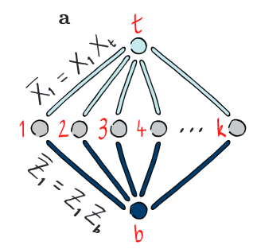

Build “logical qubits” with quantum error detection code
Improve the logical fidelity at the cost of the shot overhead by post-processing measurement outcomes.
Employ $⟦n+2, n,2⟧$ error detection code (Iceberg code) [1]
Add two qubits (t and b) to introduce redundancy for error detection. Stabilizers are: $S_{X}=X_{b}X_{1}⋯X_{n}X_{t}, { S}_{Z}=Z_{b}Z_{1}⋯Z_{n}X_{t}$
Any weight-one errors may be detected by exploiting the redundancy.
The shot is discarded when an error is detected.
Hardware experiments have been done on Quantinuum devices [1,2,3]
[1] C. N. Self et al., Nat. Phys. 20, 219 (2024).
[2] K. Yamamoto et al., Phys. Rev. Res. 6, 013221 (2024).
[3] Z. He et al.,, arXiv:2409.12104.

Slide 17

Error detection code tailored to Quantinuum hardware
Exploit the unique features of the Quantinuum hardware stack
All-to-all connection
Ancilla qubits for error detection are connected to all the data qubits.
Mid-circuit measurement and qubit reuse
Recycle the ancilla qubits for the syndrome measurements.
Conditional logic
Early exit if an error is detected.
Syndrome measurement (Mid-circuit error detection)
All these features will also be useful for quantum error correction.

Slide 18


Demonstration
QPE with quantum error detection on Quantinuum backends
Take a one-qubit Hamiltonian representing a hydrogen molecule: $H=h_{0}X+h_{1}Z+h_{2}I$
Use the information theory QPE (maximum likelihood estimate)
Use the $⟦4, 2, 2⟧$ quantum error detection (iceberg code) to encode the logical circuit
Execute this with CUDA-Q on Quantinuum backends
$$k$$

Slide 19
Demo Time
https://github.com/Karl-JT/SCA25-NVIDIA-Quantum-Workshop/tree/main/Quantinuum

Slide 20

The future of computing is here:
Where quantum and classical merge to explore new use cases.
Seamless Hybrid Computing Leverage CUDA-Q to build, optimize, and deploy quantum-classical workloads effortlessly.
CUDA-Q, NVIDIA’s cutting-edge quantum-classical hybrid platform, seamlessly integrates with Quantinuum’s industry-leading quantum hardware, unlocking computational capabilities for scientific discovery, optimization, and AI.
Superior Quantum Performance Run quantum circuits on Quantinuum’s high-fidelity trapped-ion processors, delivering the accuracy and flexibility needed for real-world applications.
Sign up here
to apply for promotional access
Accelerate Innovation
From materials science to financial modeling, push the boundaries of what’s possible with the combination of CUDA-Q and Quantinuum.
© 2025 Quantinuum. All Rights Reserved.

